Slide 1
GPS and GSM Based Tracking System

Slide 2
INTRODUCTION

Slide 3
OBJECTIVE
Goal: To create an tracking System for all purpose use.
Application : Vehicle Tracking System, Mobile tracking system.
This project uses GPS and GSM Technology and Arduino Uno.

Slide 4
HARDWARE USED
Arduino Uno
Bluetooth Module(HC-05)
GPS Module(NEO-06)
GSM module
LCD 16X2 Alphabetic Display

Slide 5
ARDUINO UNO

Slide 6
ATmega328 micro controller Based System.
Advantage :
Easy to Use
Open Source Platform
Low cost

Slide 7
BLUETOOTH MODULE
Bluetooth module is basically a part of serial communication module.
We are using HC-05 module for communication with the app.
Advantage: wireless communication.
Disadvantage: Range of communication.

Slide 8
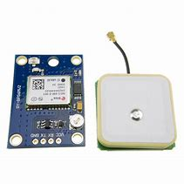
GPS MODULE(NEO-06)
GPS - Global Positioning System.
GPS is a Global Navigation Satellite System created by United State Department of Defense.
This system is self collaborative and can be used in field.
GPS accuracy is related to the quality of signal reception.

Slide 9
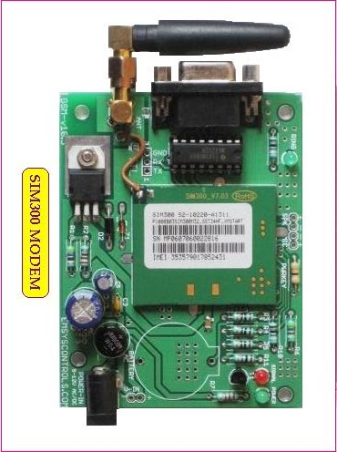
GSM MODULE(SIM-300)
GSM – Global System of Mobile Communication
Most widely used digital wireless telephone technology.
Single Supply voltage 12v.
Circuit- Switch network optimized for full-duplex link voice telephony.
It operates at either 900MHz frequency band.

